Slide 1
DIGITAL PORTFOLIO
STUDENT NAME: E.F. HILMIYA NOORIN
REGISTERNOANDNMID: 2428B0223 AND 2C6BBA4331B4F29ABDD4556DCA2037
DEPARTMENT: BSC COMPUTER SCIENCE WITH DATA ANALYTICS
COLLEGE: COLLEGE/ UNIVERSITY: TIRUPUR KUMARAN COLLEGE FOR WOMEN/ BHARATHIYAR UNIVERSITY

Slide 2
PROJECT TITLE
ARTIFICIAL INTELLIGENCE PORTFOLIO

Slide 3


AGENDA
Problem Statement
Project Overview
End Users
Tools and Technologies
Portfolio design and Layout
Features and Functionality
Results and Screenshots
Conclusion
Github Link
3/21/2024 Annual Review

Slide 4

In today’s rapidly evolving technology-driven world, professionals and learners in the field of Artificial Intelligence (AI) require a dedicated platform to present their skills, innovative projects, and expertise. Traditional resumes often fail to highlight practical knowledge in areas such as machine learning, natural language processing, computer vision, and predictive analytics. Without an interactive portfolio, recruiters and peers may not fully recognize a candidate’s ability to solve real-world problems using AI techniqe
PROBLEM STATEMENT
In today’s fast-growing AI field, learners and professionals need a platform to showcase their projects and skills in areas like machine learning, deep learning, NLP, and computer vision. Traditional resumes often fail to highlight practical knowledge and creativity. An interactive portfolio helps demonstrate true abilities, problem-solving skills, and makes candidates stand out to recruiters

Slide 5

PROJECT OVERVIEW
Project title: Cyber Security Portfolio Website ​PUrpose : To serve as a personal digital platform for the creator to showcase their skills, projects, and knowledge in the field of cybersecurity. ​Technology stack : Built using HTML, CSS, and JavaScript. ​Design : Features a modern, dark-themed user interface key

Slide 6

WHO ARE THE END USERS?
Recruiters/Employers: They evaluate the portfolio to assess a candidate's skills for potential job opportunities. ​Peers and monitors: They use the platform for collaboration, feedback, and learning purposes. ​clients: For freelance work, clients use the portfolio to review services like penetration testing before hiring. ​The Developer: The creator of the portfolio uses it as a personal tool to track progress, showcase growth, and maintain a digital resume.

Slide 7

TOOLS AND TECHNIQUES
Tools ​Html file: Structures the website. ​Css3: Designs the look. ​Java script: Adds interactive functions. ​Techniques ​Responsive design: Works on all screens. ​User interface (UI): Professional look and feel. ​Navigation : Easy to move around the site.

Slide 8
PORTFOLIO DESIGN AND LAYOUT
​Copyright information: The copyright notice at the bottom of a webpage. ​Legal disclaimer : Fine print for terms and conditions, privacy policies, or legal notices. ​Captions: Text that accompanies images, charts, or figures. ​Footnites: Additional details or citations placed at the bottom of a page. ​Metadata: Information like publication dates, author names, or article categories.
8

Slide 9
FEATURES AND FUNCTIONALITY
Key Features: ​Language understanding: Interprets what you type or say. ​Knowledge: Has a huge amount of information. ​Context: Remembers our conversation. ​Key Functions ​Answers Question: Gives information on any topic. ​Creates Context: Writes emails, code, and stories. ​performs task: Helps with summarizing and translating

Slide 10
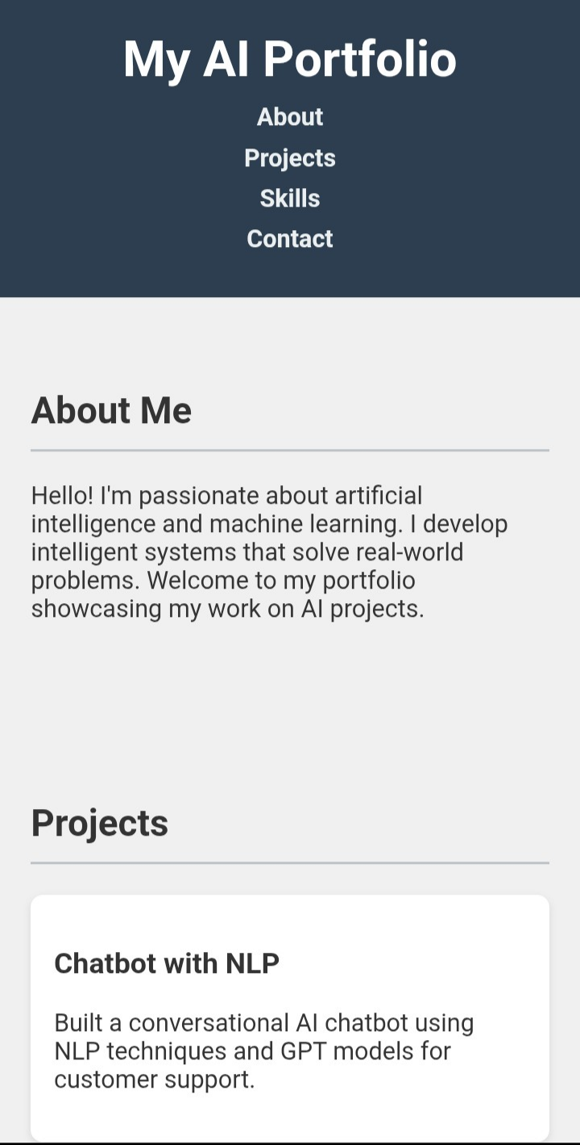

RESULTS AND SCREENSHOTS
3/21/2024 Annual Review
10

Slide 11
CONCLUSION
Artificial Intelligence is one of the most advanced technologies shaping our present and future. It helps solve complex problems with speed and accuracy. AI is transforming fields like healthcare, education, business, and communication. It increases productivity and creates new opportunities for innovation. At the same time, it raises concerns about ethics, privacy, and responsibility. Using AI wisely ensures fairness, trust, and sustainable growth. With continuous progress, AI will lead to a smarter and brighter world.
11

